Slide 1
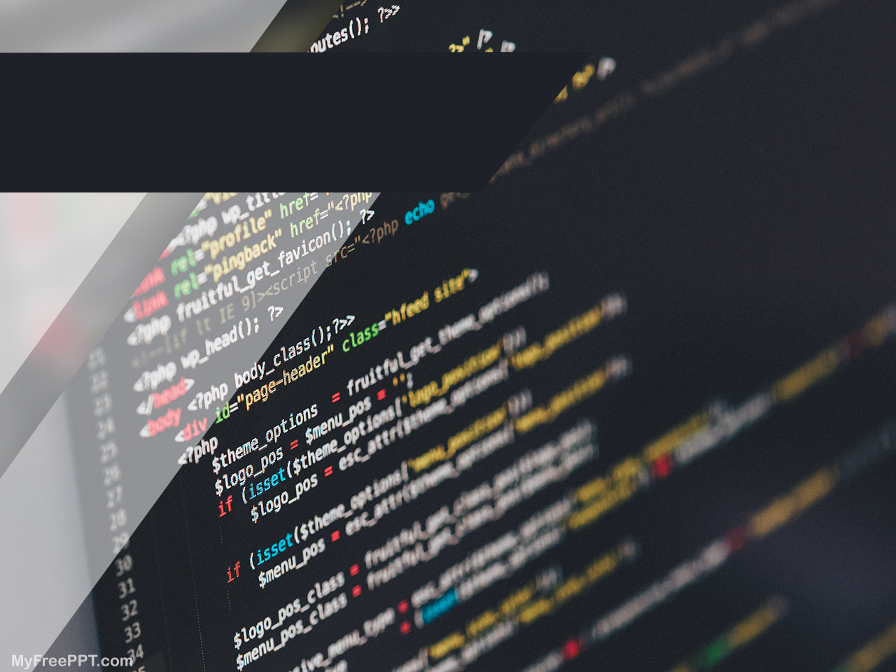
MY EXPERIENCE WITH CODING
By Diep Vu (Emma)
“I affirm that I have carried out my academic endeavors with full academic honesty.“ [Signed, Diep Vu]

Slide 2

Notes:
https://www.youtube.com/watch?v=Dv7gLpW91DM

Slide 3


Best part of coding
Problem-solving: coming up with optimal solution to a problem so that I can be more strategic, flexible and creative. I can apply those assets to solve real-life problems. I once created a website called ‘Green’, which raised people awareness of sustainability and environment protection.

Slide 4

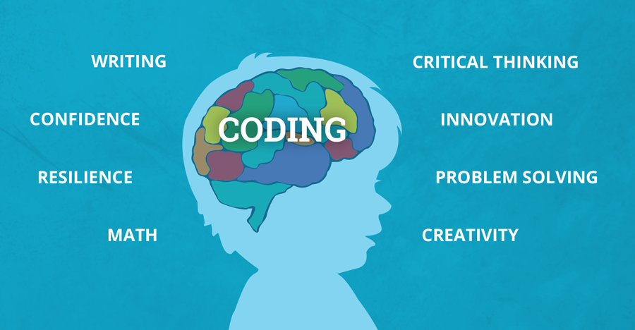
Best part of coding
Creativity: Coding has enabled me to build something out of nothing. Thanks to those ‘aha’ moments from coding, I can have my imagination run wild and create something that is useful and highly applicable in real life: ‘Fastion’ app – which chooses outfits for the users.

Slide 5
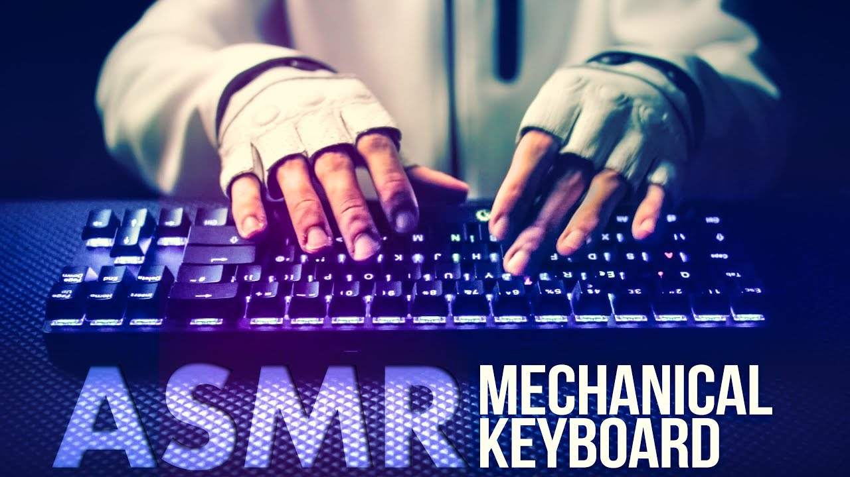

Best part of coding
Satisfaction: when my program runs smoothly for the first time or when I successfully debug your program, the feeling is indescribable. The sound of my keyboard is oddly satisfying.

Slide 6

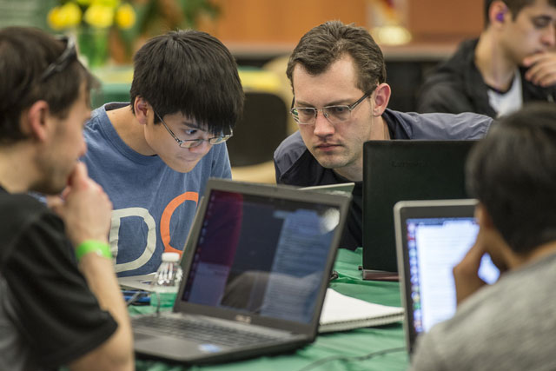
Best part of coding
Networking: I learn from the best and get to know many experts from STEM field by being the ambassador of Harvard WECode conference; taking part in hackathons

Slide 7
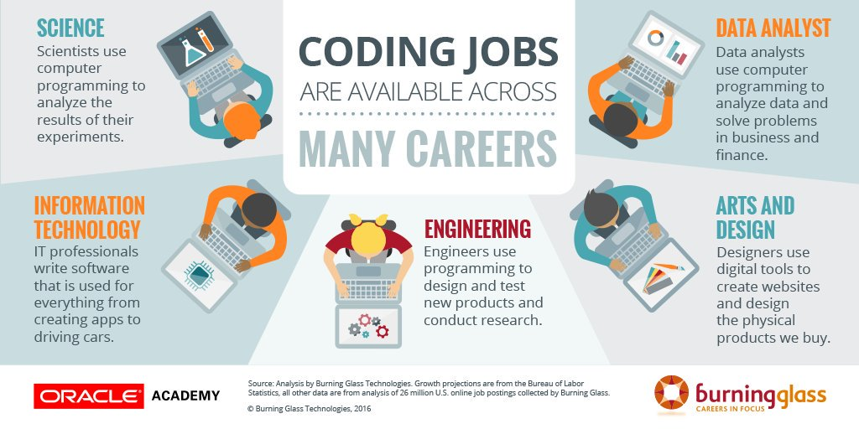
Best part of coding
Promising opportunities: I have the chance to get high-paid and most-wanted job in the market. I want to be a data analyst or software engineer in the future and coding widens my career path.

Slide 8
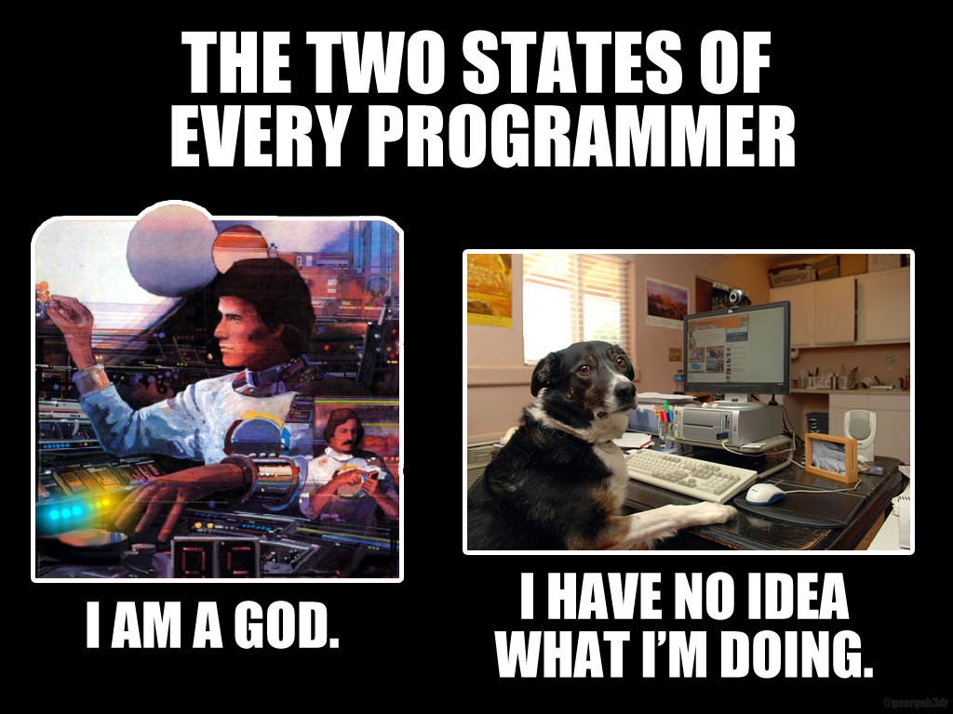
Hardest part of coding

Slide 9
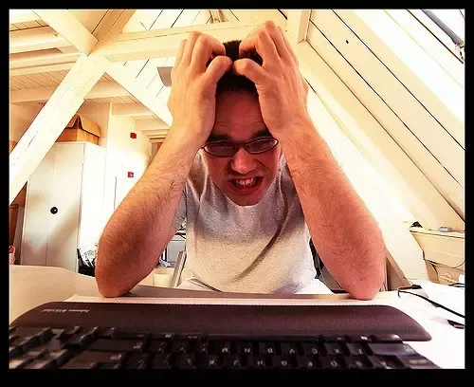
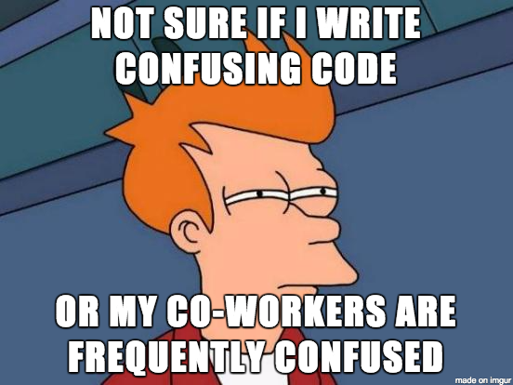
Hardest part of coding
Don’t know where to start: Initially, I learned about the syntax of a programming language but didn’t know the logic behind it, what I am going to do with it. I felt like I gained a lot of knowledge but I had no idea what to do with it. I felt overwhelmed with the resourceful information online.

Slide 10

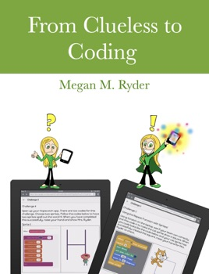
Hardest part of coding
Clueless: I found it hard to choose which programming language to start with (Python, Java, C#, Ruby), where and how to learn (online courses, books, Quora, bootcamp), what to learn (Mobile app, AI, Web, Machine Learning)

Slide 11
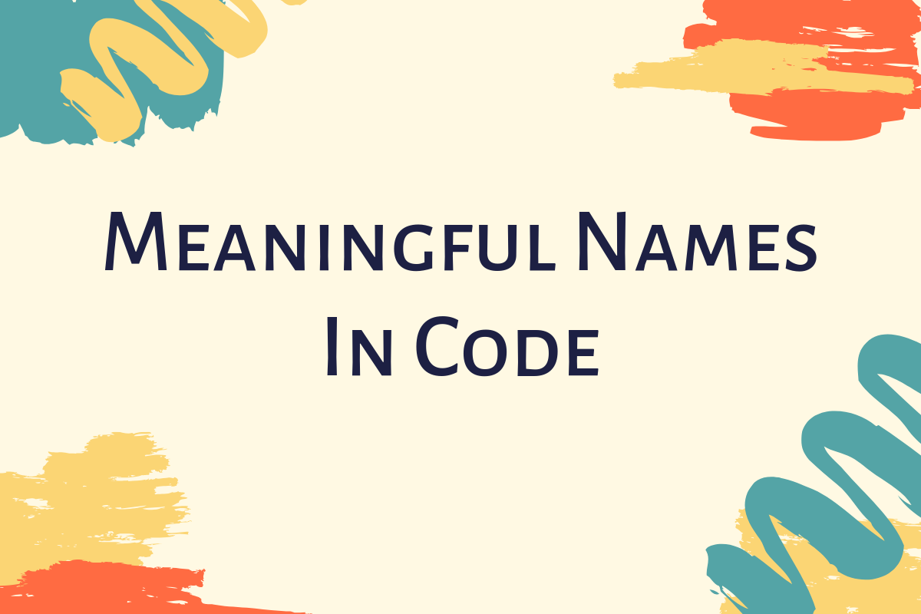
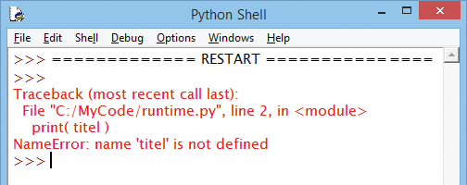
Hardest part of coding
Name things: sometimes there are so many variables and I run out of names and ideas to name them easily to remember

Slide 12
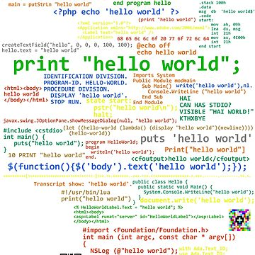
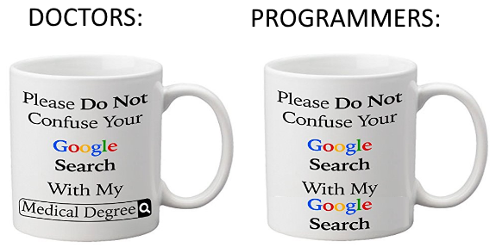
Hardest part of coding
Terminology: I get confused with so many terms in different programming languages and often mix them up. Sometimes the terminology seems abstract and more like machine-readable.

Slide 13

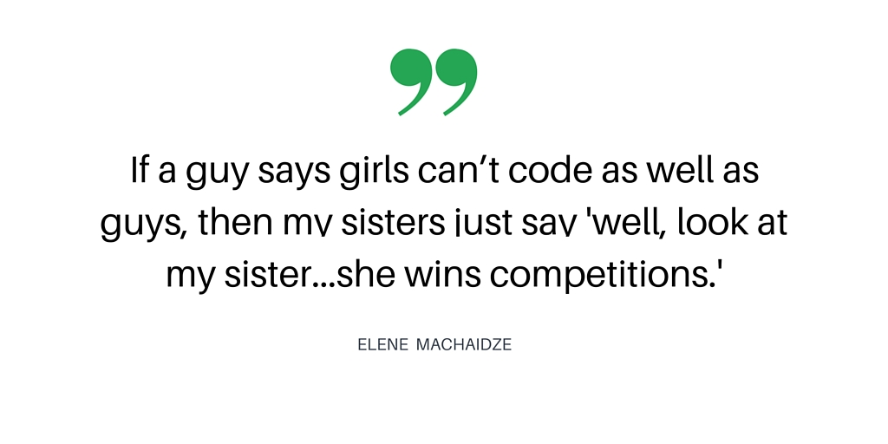
Hardest part of coding
Stereotype: People usually assume that coding is mostly for boys and girls are not cut out for doing STEM. They even assume that coders are night-owls or nerds. Many people discourage me from learning programming and they make offensive or sexist judgements.

Slide 14

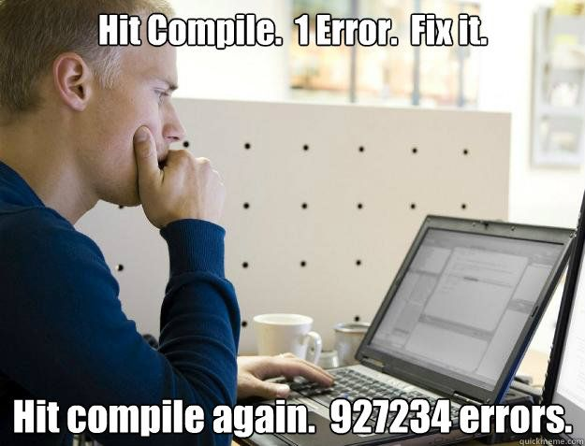
Hardest part of coding
Error: I get frustrated when my codes don’t run after spending hours of writing them. These trivial errors like syntax, missing parentheses, colons, unassigned variables sometimes make me panic but the result after fixing it is satisfying.

Slide 15
